Slide 1


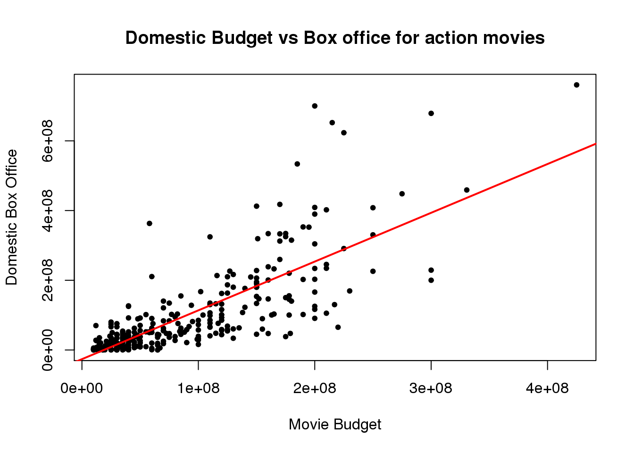
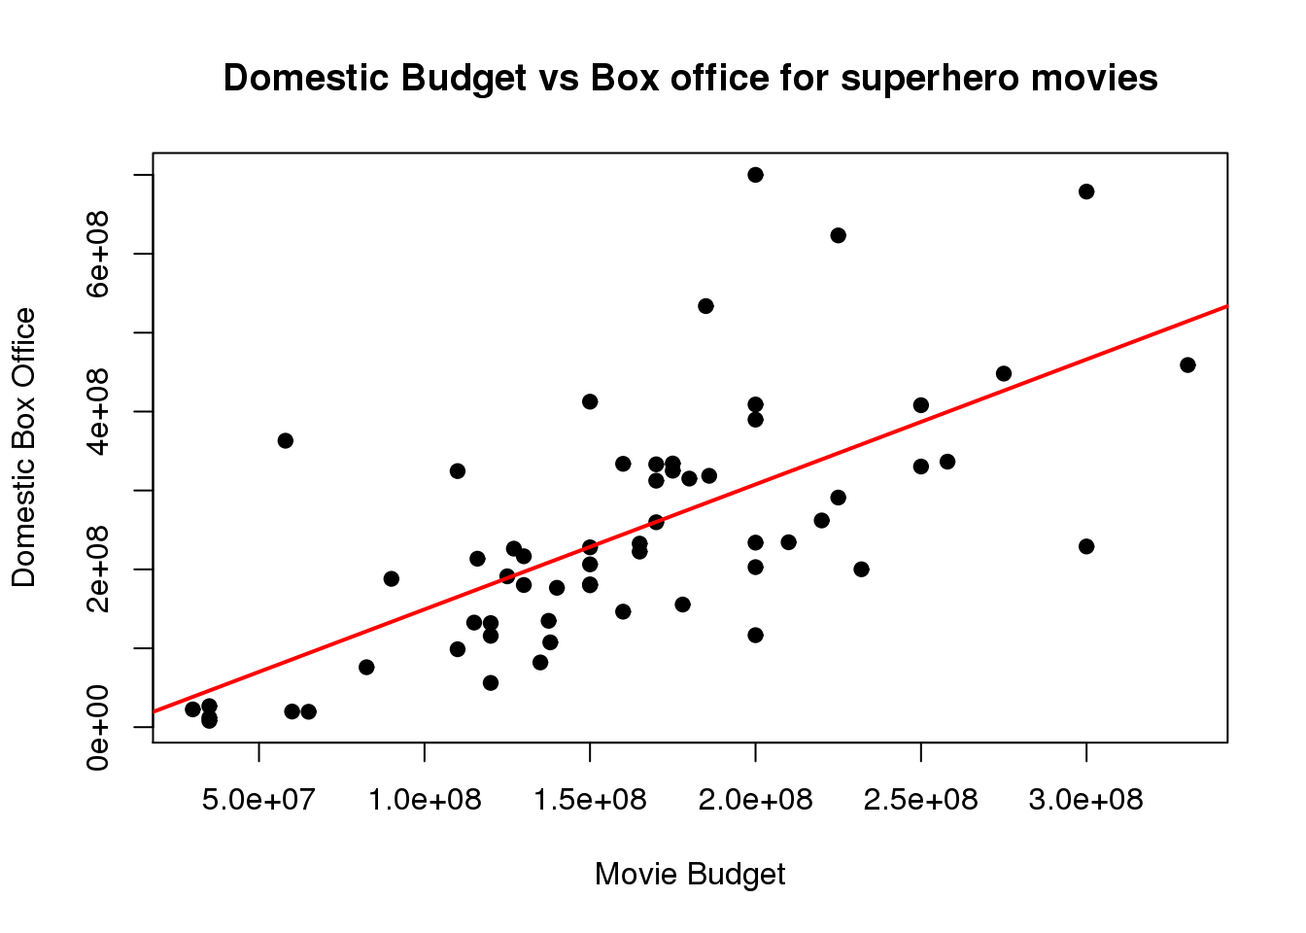
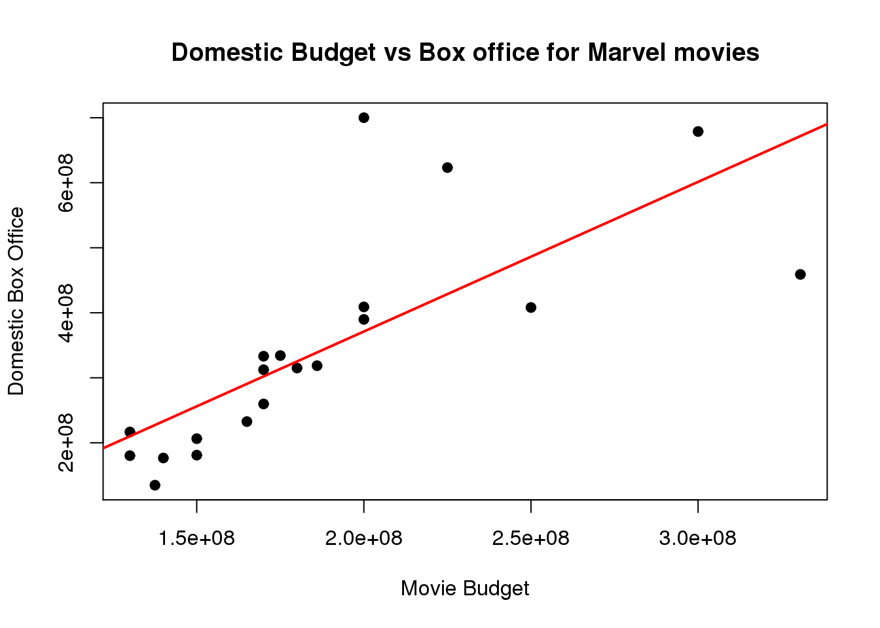
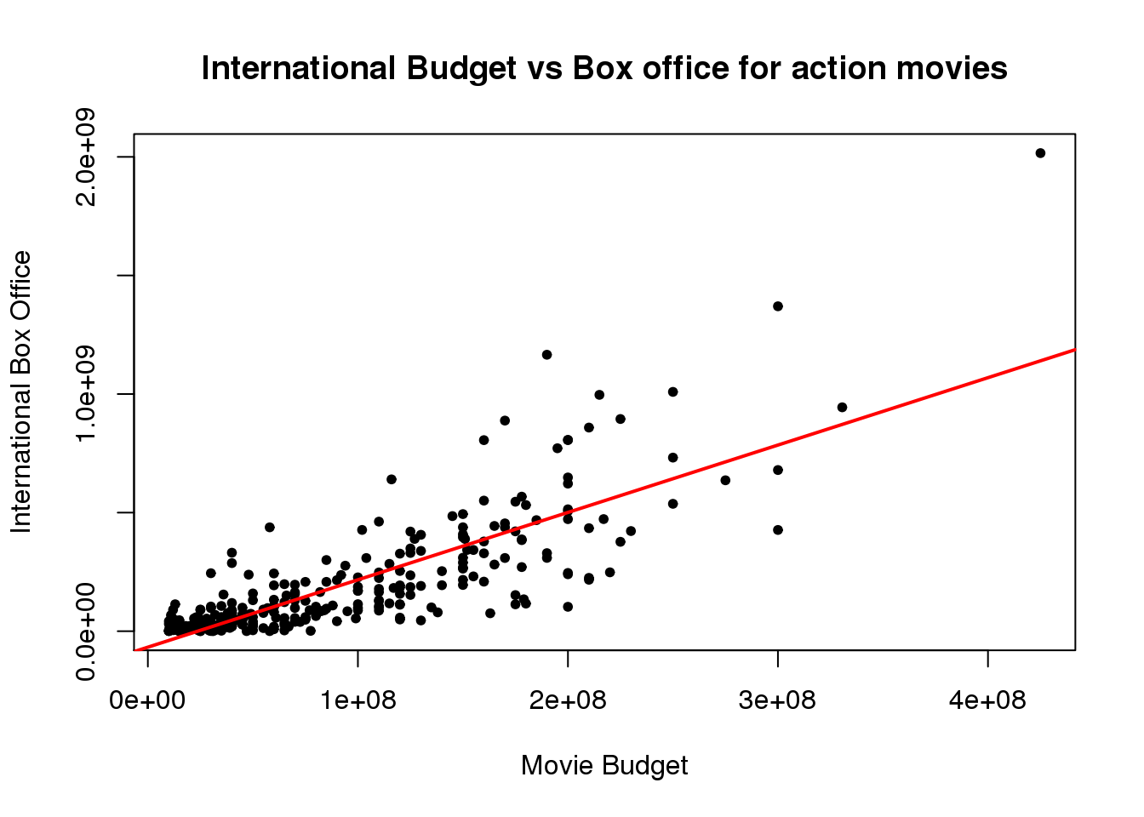
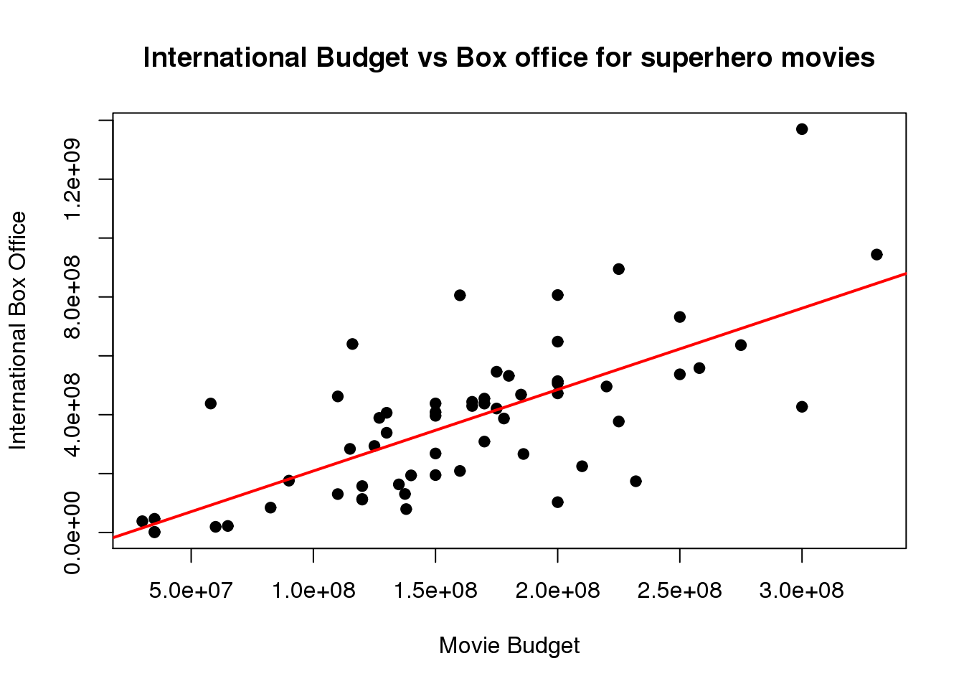
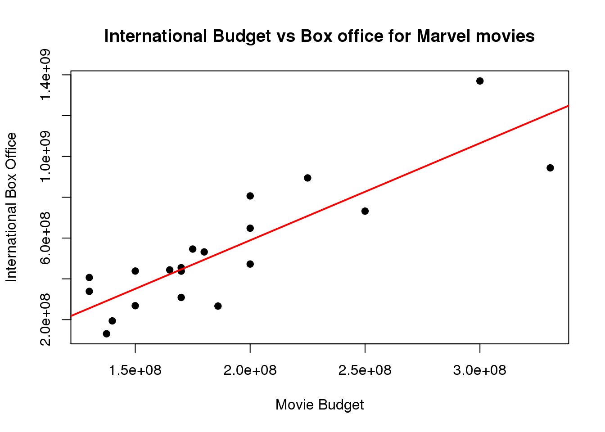
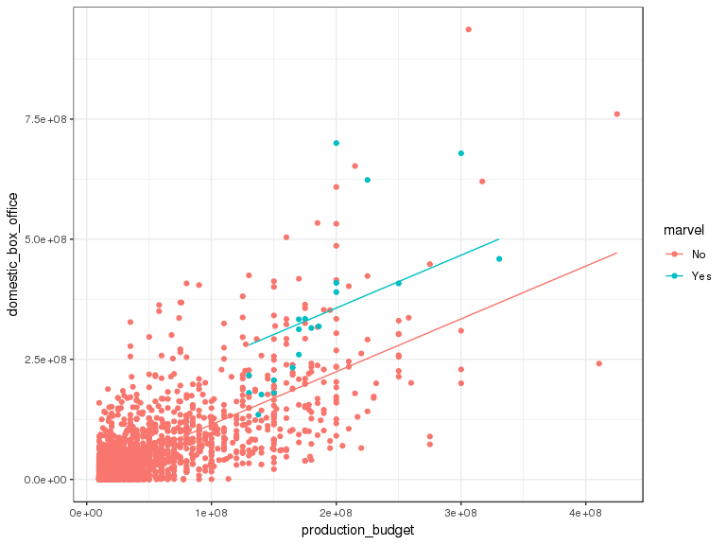
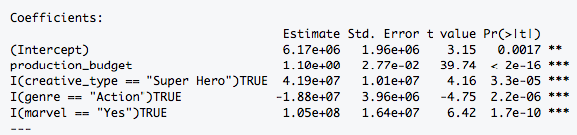
Are Marvel Movies Better than its Competitors?
Adam Boxer, Dohyun Lee, Chris Mathew
Swarthmore College, 19081, PA
Background and purpose
Results & Conclusion
Slope differences
Domestic budget vs box office
Martin Scorsese, in a recent NY Times article, voiced his frustration with recent trends in the production of movies, stating:
“In the past 20 years, as we all know, the movie business has changed on all fronts. But the most ominous change has happened stealthily and under cover of night: the gradual but steady elimination of risk. Many films today are perfect products manufactured for immediate consumption.”
“That’s the nature of modern film franchises: market-researched, audience-tested, vetted, modified, revetted and remodified until they’re ready for consumption … And I fear that the financial dominance of one is being used to marginalize and even belittle the existence of the other.”
As a group of avid cinema enthusiasts, we were motivated to investigate if Scorsese’s opinion could frame a statistically significant experiment where we can determine whether modern movies’ financial earnings would crowd out the traditional movies that Scorsese values
Our dataset was obtained from Mr. Bruce Nash of Nash Information Service after contacting him through email. It included movies from 2006 to 2018 and contained both quantitative and categorical variables, including production budget, domestic and international box office revenue, movie ratings, genre, and more
95% Confidence Interval for Slope
[1.272,1.528]
95% Confidence Interval for Slope
[1.532,1.808]
95% Confidence Interval for Slope
[2.165,2.435]
According to the confidence interval we obtained from running data shown above, we can see that there is no interception in all three confidence interval. In other words, we are 95% sure that superhero movies generally make more money than action movies, and that Marvel makes more money than the average superhero movie.
International budget vs box office
Methods
Using RStudio, our group first simplified our original dataset into three subsets, creating an individual group for action movies and, using a new variable, were able to successfully generate an additional subset specifically for Superhero movies and one for Marvel movies.
Using these two datasets, we plotted the production budgets of these movies against the domestic box office revenue and the international box office revenue. We then created 95% confidence intervals, comparing this alongside the slopes of the plots to see if:
there was a difference in the slopes
there was any overlap amongst the confidence intervals of the slopes
We did this because, if there was an overlap between the two intervals, our experiment would suggest that there was not a statistically significant difference between Marvel movies and action movies. However, if there was not an overlap, our analysis would imply that Marvel movies may, in fact, make more many than other action movies, proving Scorsese’s claim that, “... the financial dominance of one is being used to marginalize and even belittle the existence...” of other movies.
95% Confidence Interval for Slope
[2.724,2.956]
95% Confidence Interval for Slope
[2.319,3.129]
95% Confidence Interval for Slope
[4.087,5.433]
For the international box office vs budget, the confidence intervals of action movies and superhero movies overlap, which indicates that the two genres are not significantly different. However, the confidence interval of Marvel movies coincides with neither of the other two genres. So we conclude that for the international box office, action movies earn as much money as superhero movies, but Marvel earns more than both of the two genres.
The multiple regression graph on the left predicts what the Domestic Box Office would be taking into account two variables. The graph shows that when the same production budget is taken into account, a Marvel movie will have a higher Domestic Box Office than if it were not. The table to the right shows a multiple regression fitted with an additional two other categorical variables.
Discussion
Reference
The data set only includes production budget (neglecting total cost, which includes a large proportion in advertising), which may be one of the reasons why Marvel is doing so well financially — this could lead us to different results and conclusions. However, we can still hold the conclusion that Marvel flourishes in the box office and crowds out other movies.
Scorsese, Martin. “Martin Scorsese: I Said Marvel Movies Aren't Cinema.
Let Me Explain.” The New York Times, The New York Times, 5 Nov. 2019.
Nash, Bruce. MovieData, 2006-2019.
Notes:
Revisions:
Reduce text
Figures & captions of figures
Image from Zheng paper
Current State of Art
Image from Robey paper
Reduce using deep learning
Experimentally prove Robey Paper
Merge with study objectives
Discussion photo in Methods
Numbered list of things done
Caption on photograph for step 1
Numbering
Need higher resolution version for image
Everything past tense
Results section
Inclusion of target image

